Slide 1

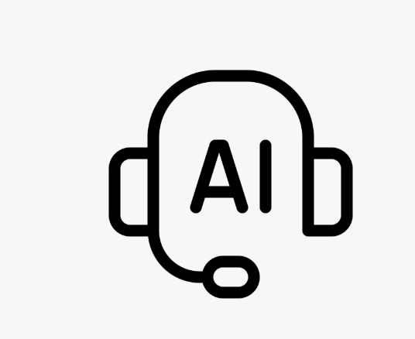
About us
AI-Powered Task Assignment
Smart. Fast. Balanced
At Contoso, we empower schools to foster collaborative thinking to further drive education and innovation. By closing the loop on STEM education, we help schools build a curriculum that will help students succeed in college.
Step into the future of workforce management.

Slide 2

Why We Built This System
Time-consuming
🎯 Prone to Bias
⚖️Ignores Workload
⏳
Manual assignment wastes valuable time on repetitive decisions.
Assignments may unfairly favor certain employees.
Current employee workload is rarely considered.

Slide 3

Solution
BALANCED WORKLOAD
🤖 AI-POWERED RECOMMENDATIONS
Uses Ollama & Mistral LLM to recommend the best employee.
⚖️BALANCED WORKLOAD
Fairly distributes tasks based on current employee load.
🖥️ FRONTEND
Quick and intuitive task submission via web form.
🔒 SECURE & PRIVATE
Keeps all data local, protecting sensitive information

Slide 4

SYSTEM ARCHITECTURE
Backend
Python Flask server exposing APIs and connecting to database & AI model.
Frontend
HTML/CSS/JavaScript web form for task submission and viewing recommendations
Database
MySQL database stores employees, tasks, & workload.
AI Model
Ollama + Mistral LLM generates intelligent task assignment suggestions.

Slide 5

HOW IT WORKS ?
Step 1 :Input Manager enters task title, required skills, and priority in the web form
Step 2 :Mode Selection Manager chooses either AI-powered assignment or Rule-based assignment. Step 3 :Processing Backend queries AI or applies rules, determines the best employee, and updates workload.
Step 4 : Output Recommendation is shown to the manager and saved in the database.

Slide 6

DEMO: See It In Action
Step 1 — Open the Web Page Manager opens the web form in the browser. Step 2 — Enter Task Details Fill in Task Title, Required Skills, and Priority. Step 3 — Choose Mode Click Assign with AI or Assign with Rules. Step 4 — See Recommendation
Assigned employee appears, and task is saved to the database

Slide 7




Conclusion
Smart & Efficient
Fair Workload
Automates task assignment intelligently using AI & rules.
Ensures employees are assigned tasks based on skills and current workload.
Local & Private
Easy to Use
Data stays secure and private on local servers
Simple web interface, no technical expertise needed.

Slide 8

Future Work
What’s Next?
Let employees give feedback on their tasks.
Make it work better for remote and hybrid teams.
Improve the AI by checking how well it performs over time.
Allow it to handle more teams and bigger companies.
Help managers plan tasks before problems happen.

Slide 9

Thank you
Zainab Awada 6146
Zeina Balhas 5998
Hassan hijazi 5922

